Slide 1
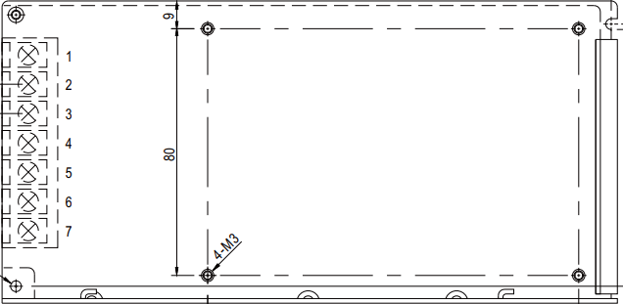
Exhaust
Side
Top side (power supply)
Drill 3-3.2mm ⌀ holes
(1/8”)

Slide 2
Left side (fan side)
Cut 115.6mm (4.5”) ⌀ inner circle
Drill 4.0-4.3mm ⌀ outer holes
(11/64”)

Slide 3
Right side (exhaust side)
Cut 115.6mm (4.5”) ⌀ inner circle
Drill 4.0-4.3mm ⌀ outer holes
(11/64”)

Slide 4
Exhaust
Side
Bottom side (Arduino, alarm)
Drill 3-3.2mm ⌀ holes
(1/8”)

Slide 5
Exhaust
Side
Top side (power supply)
Drill 3-3.2mm ⌀ holes
(1/8”)

Slide 6

On-Board Output
(Do not load)
External
Thermistor
8.2mm
21/64”
6mm
15/64
Analog Input 1
(diode)
External Analog Input
8.2mm
21/64”
8.2mm
21/64”
Current Sense
8.2mm
21/64”
8.2mm
21/64”
Analog Input 2
USB
LED
Digital I/O 1
8.2mm
21/64”
15mm
5/8”
8.2mm
21/64”
9.6mm
3/8”
14.3mm
9/16”
Digital I/O 2
8.2mm
21/64”
Bottom side
Back side (I/O connections)
3.2mm (1/8”) Ground
6mm (15/64”) for mono
8.2mm (21/64”) for BNC
8.2mm (21/64”) for LED(l)
9.6mm (3/8”) for LED(r)
14.3mm (9/16”) for AC
15mm (5/8”) for USB

Slide 7
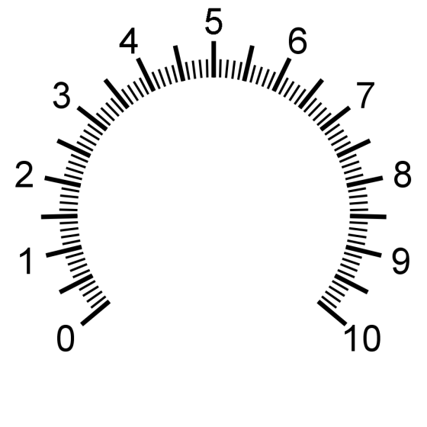
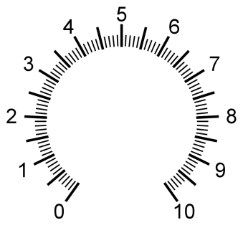
Overheat
Warning
LED Intensity
Fan Speed
Auto
Manual
Power
Bottom side
Front side (Controls)
**Drill keys first
7.2mm (9/32”) for pot
3.2mm (1/8”) for pot key
20mm(13/16”) AC switch
2.4mm (3/32”) AC key
5mm (13/64”) LED
6.4mm (1/4”) Toggle
2.2mm (3/32”) Toggle key

Slide 8

Auto
Manual
Front side (Controls)
**Drill keys first
7.2mm (9/32”) for pot
3.2mm (1/8”) for pot key
9.8mm(25/64”) SP4T
3.2mm(1/8”) SP4T key
20mm(13/16”) AC switch
2.4mm (3/32”) AC key
5mm (13/64”) LED
6.4mm (1/4”) Toggle
2.2mm (3/32”) Toggle key
Overheat
Warning
LED Intensity
420 nm
Power
375 nm
530 nm
Fan
Off
LED Selector

